Slide 1
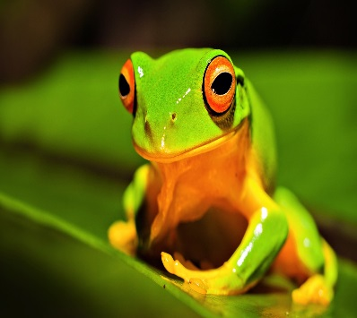
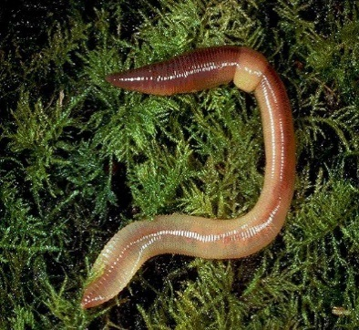

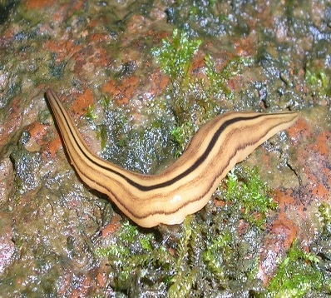
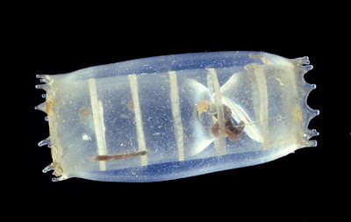
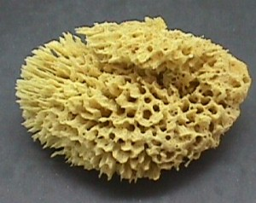
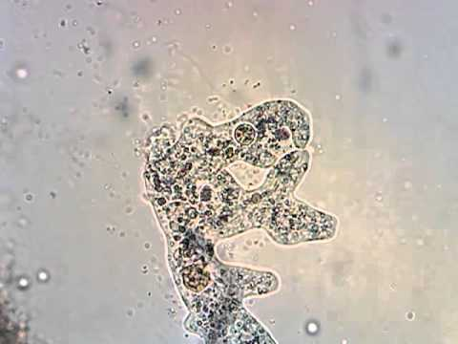
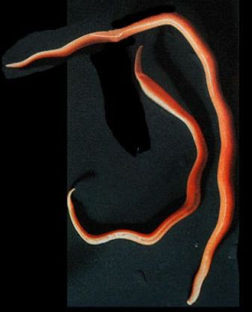
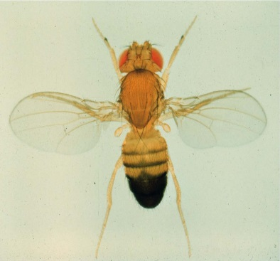
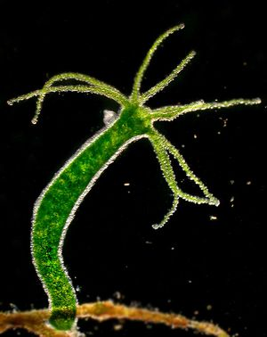
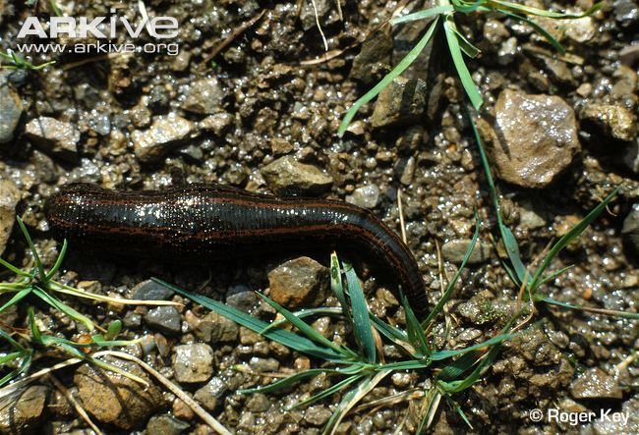
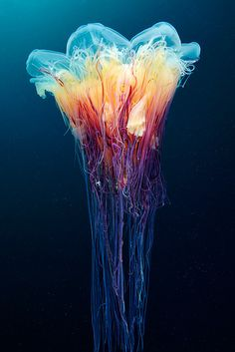
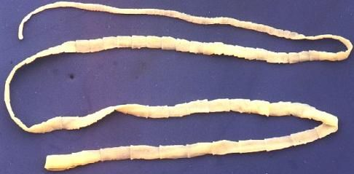
ZOOLOGY DEPARTMENT
F. Y. B. Sc.
Practical's
Prof.Ughade P.K.

Slide 2
Index
1. To study the classification with reasons of the following-
Phylum Protozoa- Amoeba, Euglena and Volvox.
Phylum Porifera- Sycon, Hyalonema and Euspongia
2. To study the classification with reasons of the following-
Phylum Coelenterata- Hydra, Physalia, and any one Coral
Phylum Platyhelminthes- Tapeworm, Planeria, Liver fluke
3. To study the classification with reasons of the following-
Phylum Aschelminthes- Ascaris
Phylum Annelida- Tubifex, Leech and Neris
4. Culturing of Paramoecium
5. Study of live Paramoecium
6. Study of external characters, binary fission and conjugation in Paramoecium
7. Study of external characters and digestive system of earthworm.
8. Study of reproductive system of Earthworm.

Slide 3
9. Study of Nervous system of Earthworm.
10. Earthworm mounting- Septal nephridia, setae and Spermatheca.
11. Study of Prokaryotic and Eukaryotic cell with the help of suitable material.
12. Study of temporary preparation of different mitotic stages from Onion root tip cells.
13. To study the classification with reasons of the following-
Hemichrdata- Balanoglossus
Urochordata- Doliolum/ Salpa
Cephalochardata- Amphioxus
14. To study the classification with reasons of the following-
Cartilaginous fishes- any two
Bony fishes- any two
Amphibia- any three
15. Study of External characters, sexual dimorphism and digestive system of Frog.
16. Study of Brain of Frog.

Slide 4
17. Study of monohybrid ratio and dihybrid ratio providing hypothetical data and deducing
applicability of Mendelian laws
18. Preparation of culture media and maintenance of Drosophila culture
19. Study of Drosophila: External characters and sexual dimorphism
20.Study of Drosophila mutant (any 2 eye and wins mutant).
21. Study of genetic trait in human being (tongue rolling, widow’s peak, ear lobe, color blindness and PTC tester/ Non-tester)
22. Study of normal human karyotype from metaphase chromosomal spread picture.
23. Study of blood group in human.
24. Study of any 3 cell organelles.
25. Compulsory visit to Vermiculture unit/ biodiversity spot/ ZSI/ large water body.

Slide 5
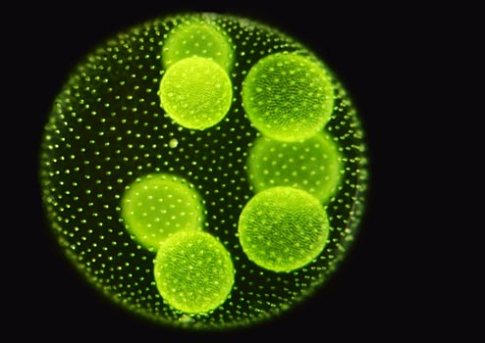
Practical No. 01
To Study the Classification with reasons of the following-
Phylum Protozoa- Amoeba, Euglena and Volvox.
Phylum Porifera- Sycon, Hyalonema and Euspongia

Slide 6
A) Phylum Protozoa-
General Characters-
These organisms are unicellular, Eukaryotic, microscopic and mostly aquatic.
Some are terrestrial.
They are either motile or non- motile.
Locomotory organs are Cilia, Flagella or Pseudopodia, etc.
The protist with or without cell wall.
If cell wall is present, it is made up of cellulose.
They have membrane bound cell organelles such as mitochondria, Chloroplast, ER, Golgi complex.
The nucleus is well organized i.e. with nuclear envelope, nucleoplasm, nucleolus, and DNA.
They show Photosynthetic, holozoic, saprophytic or parasitic mode of nutrition.
The reserve food material is in the form of glycogen or starch and fat.
Reproduction is sexual or asexual.
E.g. Amoeba, Diatoms, etc.

Slide 7
1. Amoeba
Systematic position-
Phylum- Protozoa (Microscopic and unicellular)
Class- Rhizopoda (Locomotory organ are Pseudopodia)
Order- Lobosa (Pseudopodia is lobose or filose,
Ecto and Endoplasm distinct)
Family- Amoebidae
Genus- Amoeba
Species- proteus

Slide 8
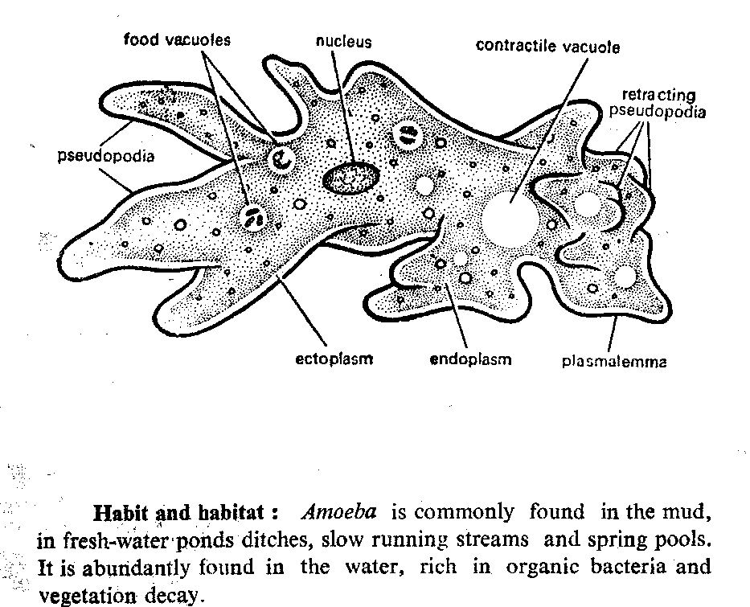
Amoeba proteus

Slide 9
2. Euglena
Systematic position-
Phylum- Protozoa (Microscopic and unicellular)
Class- Mastigophora (Locomotory organ are Flagella)
Order- Euglenoidina (Body is covered with soft and rigid Pedicle)
Family- Euglenaceae
Genus- Euglena
Species- gracilis

Slide 10
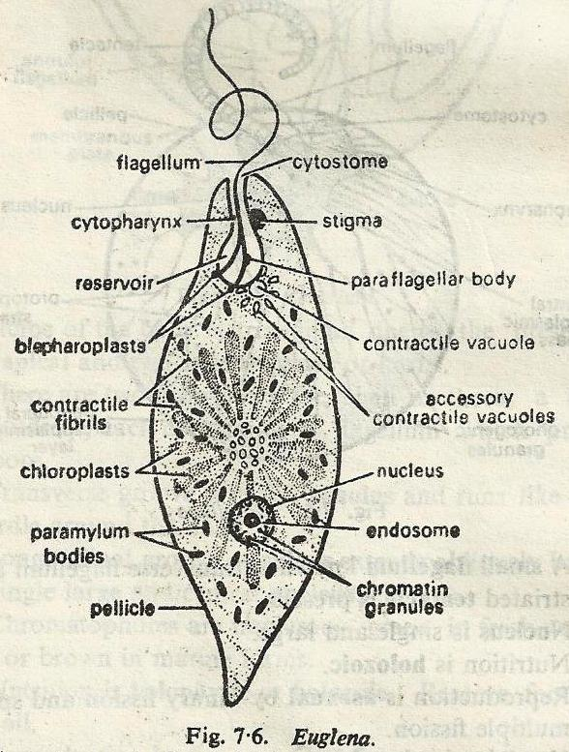
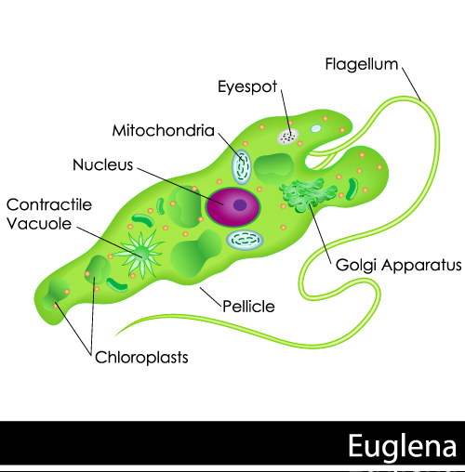
Euglena

Slide 11
3. Volvox
Systematic position-
Phylum- Protozoa (Microscopic and unicellular)
Class- Mastigophora (Locomotory organ are Flagella)
Order- Phytomonadina (Oval or elongated flagella enclosed in semi cellulose memb.)
Family- volvocaceae
Genus- Volvox
Species- carteri

Slide 12
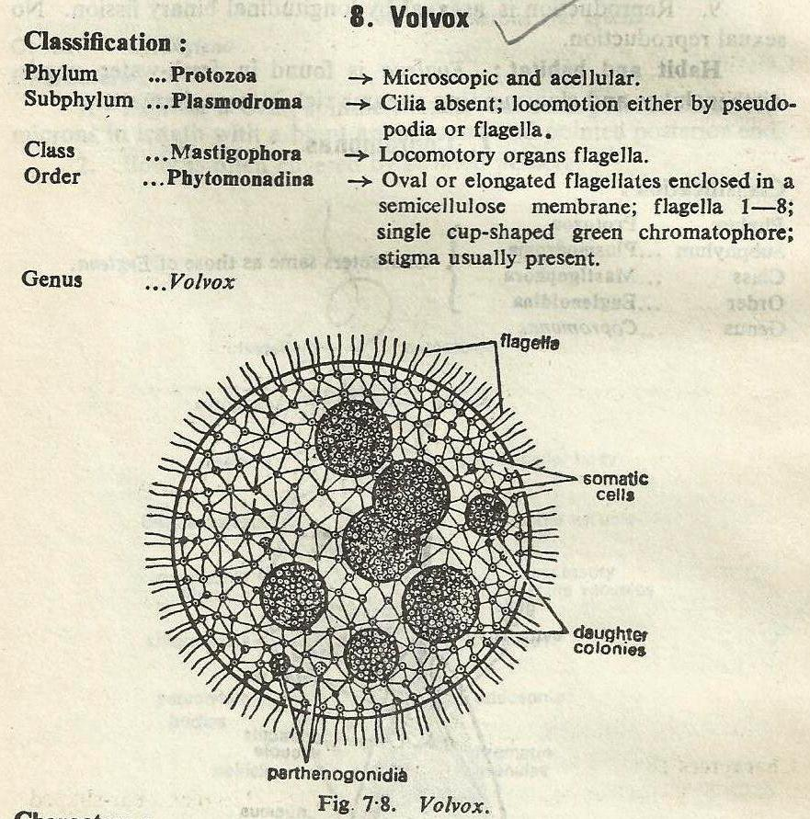
Volvox

Slide 13
B) Phylum Porifera
General Characters-
These aquatic mostly marine and few freshwater.
They are multicellular organisms.
They are sessile, solitary and conical.
Surface of body is perforated by large pores.
Number of pores and canal present.
Body is symmetrical or radially symmetrical.
Body wall is diploblastic.
Nervous system is absent.
Sponges passes great power of regeneration.
E.g. Sycon, Euspongia, etc.

Slide 14
1. Sycon
Systematic position-
Phylum- Porifera (Pore bearing)
Class- Calcarea (Endoskeleton consist of calcareous spicule)
Order- Heterocoela (Canal system is syconoid type.)
Family- Sycettidae
Genus- Sycon

Slide 15
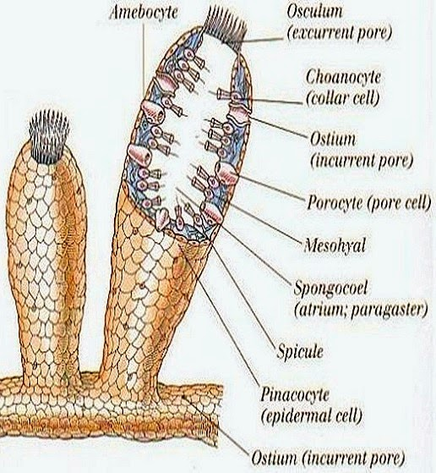
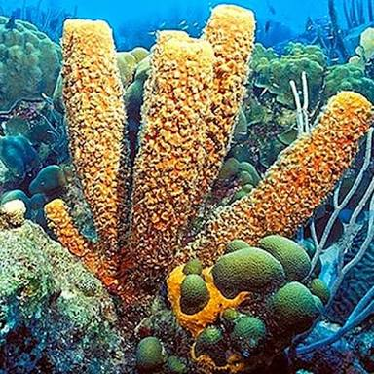
Sycon

Slide 16
2. Hyalonema
Systematic position-
Phylum- Porifera (Pore bearing)
Class- Hexactinellida (Skeleton consist of triaxon, six- rayed Siliceous spicule)
Order- Amphidiscophora (Spicules are Amphidiscs, No Hexasters)
Family- Hylonematidae
Genus- Hyalonema
Species- calix

Slide 17
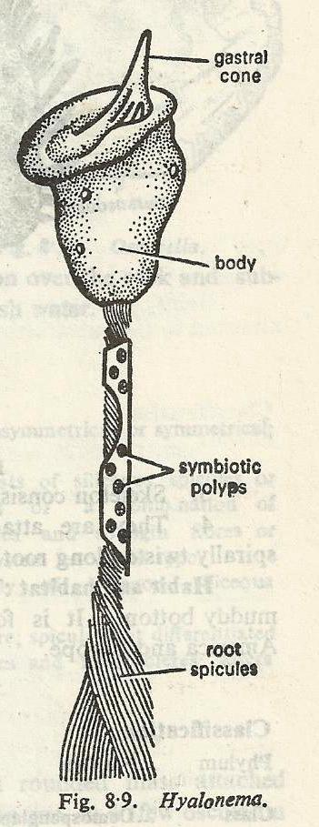
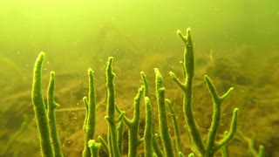
Hyalonema

Slide 18
3. Euspongia
Systematic position-
Phylum- Porifera (Pore bearing)
Class- Demospongae (Canal system is leuconoid type)
Order- Dictyoceratida
Family- Spongidae
Genus- Euspongia
Species- officinalis

Slide 19
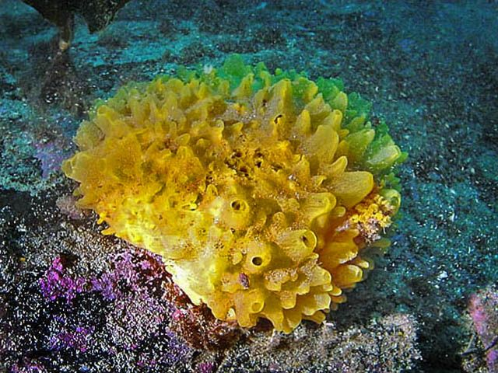
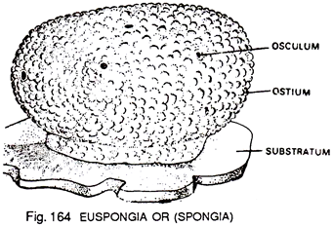
Euspongia

Slide 20
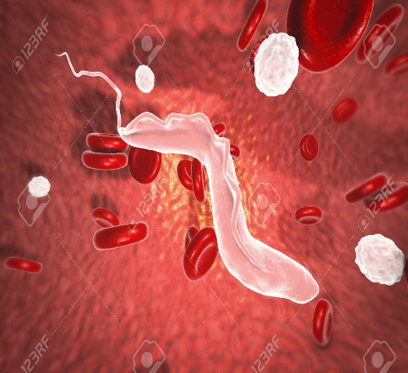
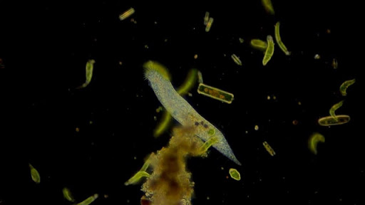
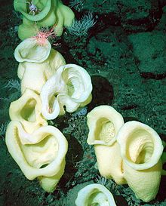
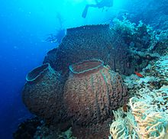
Other examples of Phylum Protozoa and Porifera
Trypanosoma Plasmodium Staurocalyptus Barrel sponge

Slide 21

Thank
You

