Slide 1
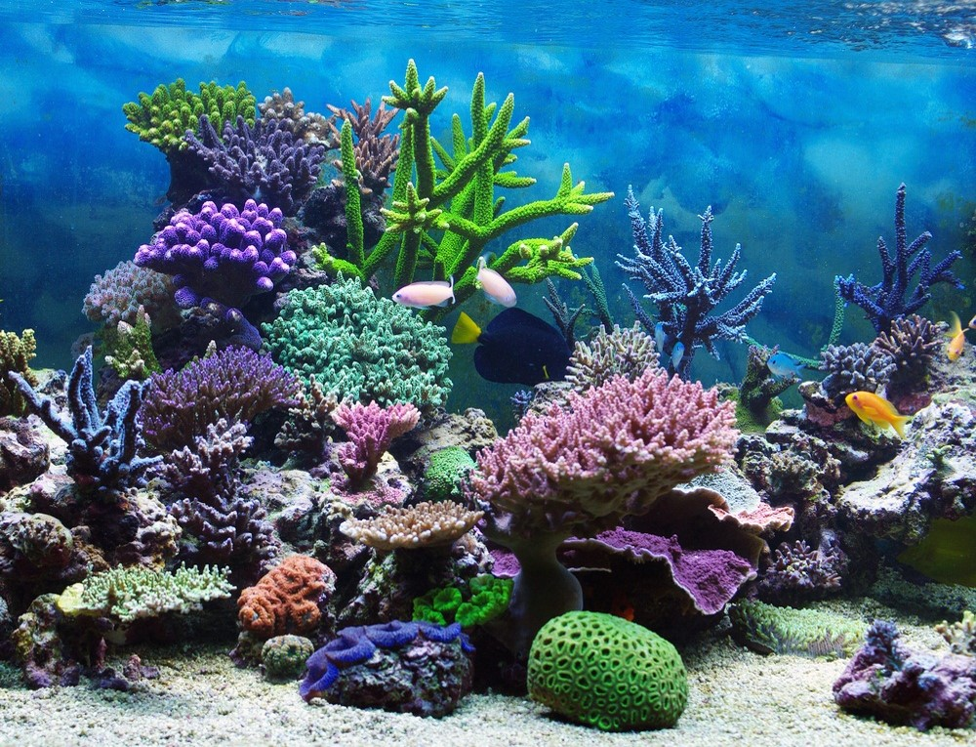
Practical No. 02
2. To study the classification with reasons of the following-
Phylum Coelenterata- Hydra, Physalia, and any one Coral
Phylum Platyhelminthes- Tapeworm, Planeria, Liver Fluke

Slide 2
A) Phylum Coelenterata
General Characters-
This animal shows radial symmetry.
They are diploblastic animals with ectoderm and endoderm.
These two layers are separated by mesoglea.
The body has coelenteron/ Gastrovascular cavity which has one opening called Mouth.
Coelom is absent.
They bears tentacles.
Nervous system is primitive.
Asexual reproduction by budding. Some allows sexual reproduction with
ciliate larval stage.
E.g. Hydra, Physalia, etc.

Slide 3
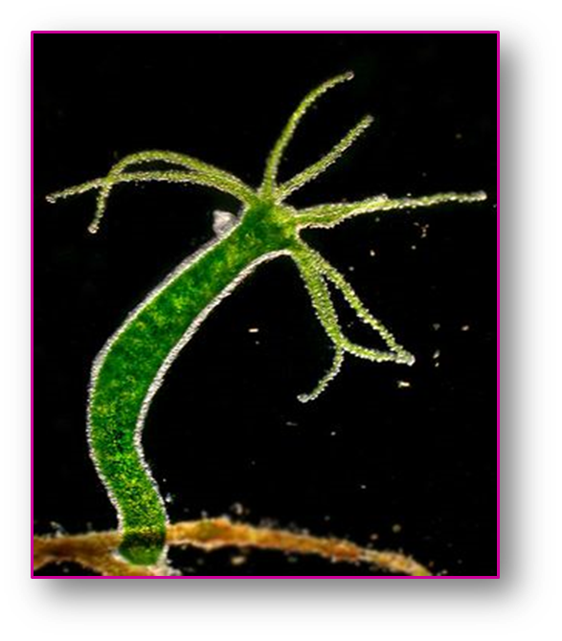
1. Hydra
Systematic position-
Phylum- Coelenterata (Multicellular, diploblastic, acoelomate)
Class- Hydrozoa (Hydroides bearing medusa with true velum)
Order- Hydroidea (Polypoid generation well developed.)
Family- Hydridae
Genus- Hydra
Species- vulgaris

Slide 4
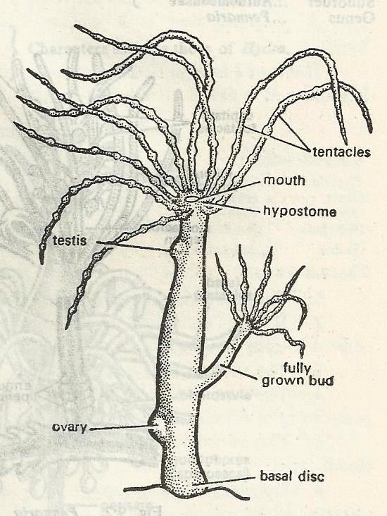
Hydra

Slide 5
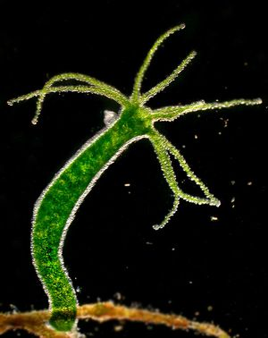
Hydra

Slide 6
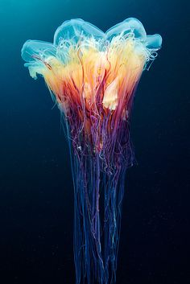
2. Physalia
Systematic position-
Phylum- Coelenterata (Multicellular, diploblastic, acoelomate)
Class- Hydrozoa (Hydroides bearing medusa with true velum)
Order- Siphonophora (Polymorphic, free swimming, colonial.)
Family- Physaliidae
Genus- Physalia
Species- physalis

Slide 7
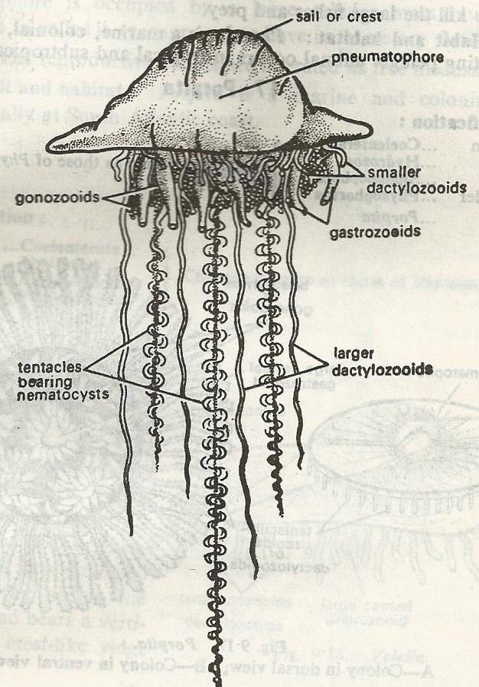
Physalia

Slide 8
Physalia

Slide 9
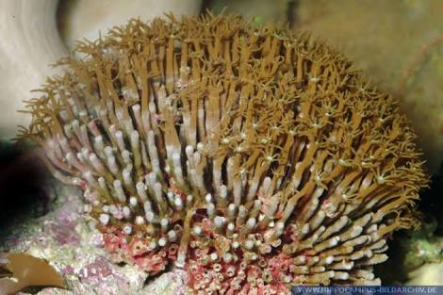
3. Tubipora
Systematic position-
Phylum- Coelenterata (Multicellular, diploblastic, acoelomate)
Class- Anthozoa (Polypoides, only polyps, polymerus)
Order- Stolonifera
Family- Tubiporidae
Genus- Tubipora
Species- musica

Slide 10
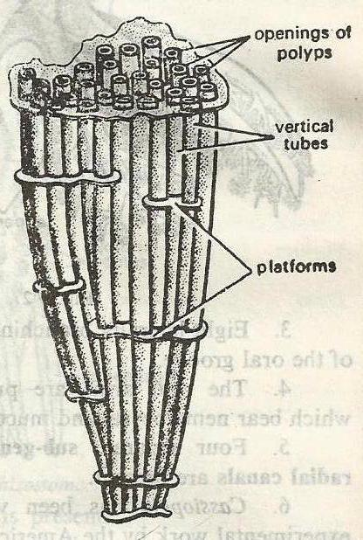
Tubipora

Slide 11
Tubipora

Slide 12
A) Phylum Platyhelminthes
General Characters-
Body is soft, showing bilateral symmetry, dorsoventrally flattened
They are free living or parasitic.
Body does not shows metameric segmentation.
They are triploblastic and acoelomate.
Hooks, spines and teeth are present at mouth region.
Digestive system and Anus is absent in some forms.
Excretory system is made up of protonephridia.
Nervous system consist of Network and Ganglia.
Most of flatworms are Hermaphrodite.
E.g. Taenia solium, Planaria, etc.

Slide 13
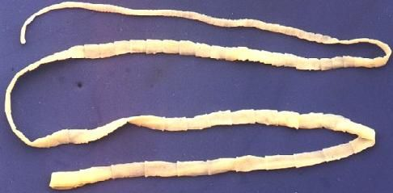
1. Tapeworm
Systematic position-
Phylum- Platyhelminthes (body dorsoventrally flattened, acoelomate)
Class- Cestoda (Endoparasite in intestine)
Order- Taenioidea (Scolex with four suckers)
Family- Taeniidae
Genus- Taenia
Species- Solium

Slide 14
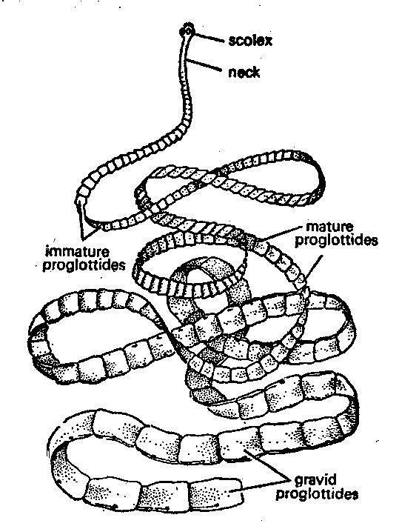
Taenia solium

Slide 15
Taenia solium

Slide 16
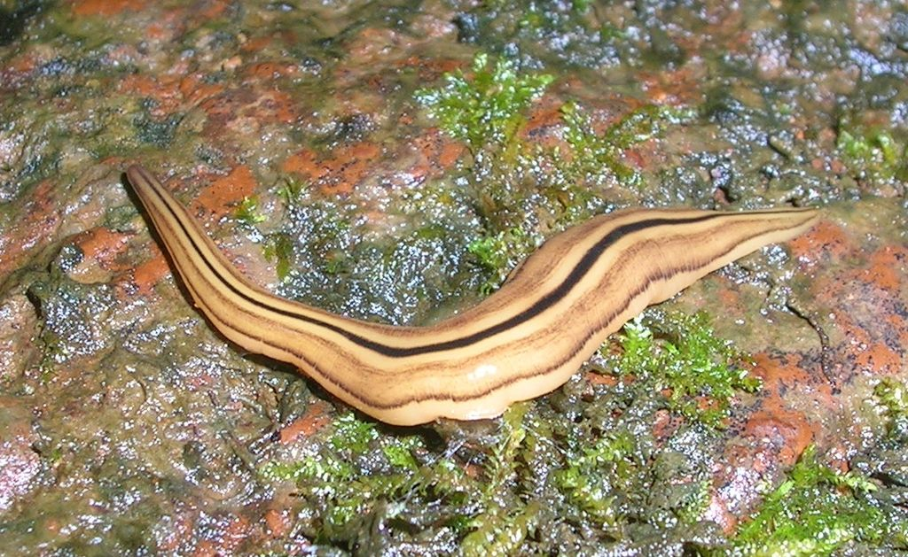
2. Planaria
Systematic position-
Phylum- Platyhelminthes (body dorsoventrally flattened, acoelomate)
Class- Turbellaria (adhesive organs present)
Order- Tricladida (Intestine with three branches)
Family- Planariidae
Genus- Planaria
Species- torva

Slide 17
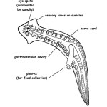
Planaria

Slide 18
Planaria

Slide 19
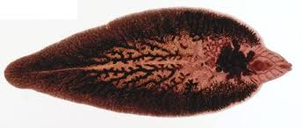
3. Liver Fluke
Systematic position-
Phylum- Platyhelminthes (body dorsoventrally flattened, acoelomate)
Class- Trematoda (Ecto and Endoparasite, suckers present)
Order- Digenea (Endoparasite, two suckers without hooks)
Family- Fasciolidae
Genus- Fasciola
Species- hepatica

Slide 20
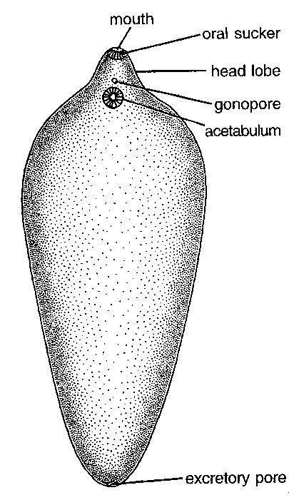
Fasciola hepatica

Slide 21
Fasciola hepatica

Slide 22
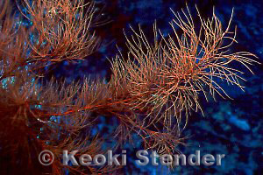
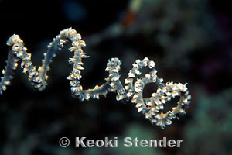
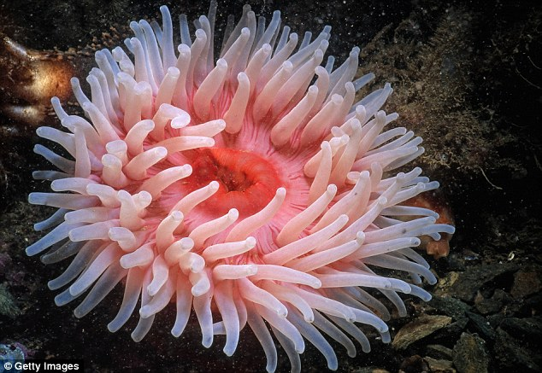
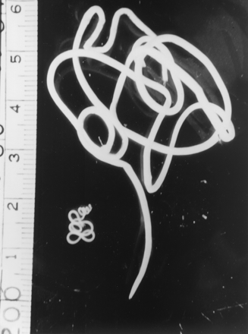
Other examples of Phylum Cnidaria and Platyhelminth
Grand black coral
Spiral coral
Sea anemone
Dracunculus

Slide 23

Thank
You

