Slide 1
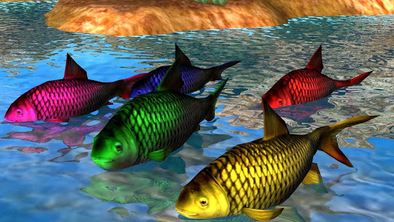
Practical No. 9
Aim- Identification, Classification and study of Habit, Habitat and Economic Importance of Rohu, Catla, Mrigal, Pomphret, Prawn.

Slide 2
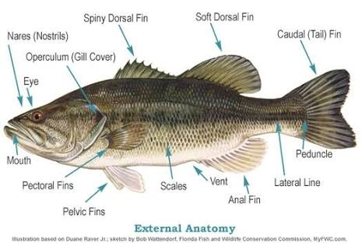

Slide 3
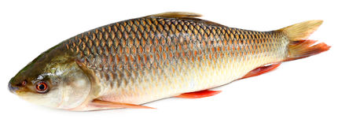
Rohu
Systematic Position-
Phylum- Chordata
Class- Pisces
Order- Cypriniforms
Family- Cyprinidae
Genus- Labeo
Species rohita
Rohu

Slide 4
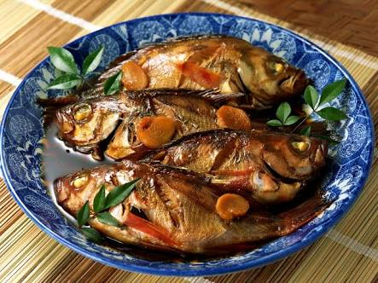
Identification characters-
Body is moderately elongated, Spindle-shaped divided into Head, Trunk and Tail.
Body is with grey colour on the back and silvery white sides.
Mouth is small, sub-terminal.
Scales are cycloid, large and orange to reddish colour in the centre.
Caudal fin deeply forked.
Habit and Habitat-
They are commonly fresh water, found in ponds and rivers.
They are vegetarian and bottom feeder.
They are widely distributed in tropical and temperate regions.
Specially found in India ( Punjab, Assam).
Economic Importance-
Labeo is economically important has great food value.

Slide 5
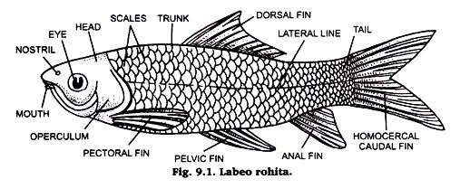

Slide 6
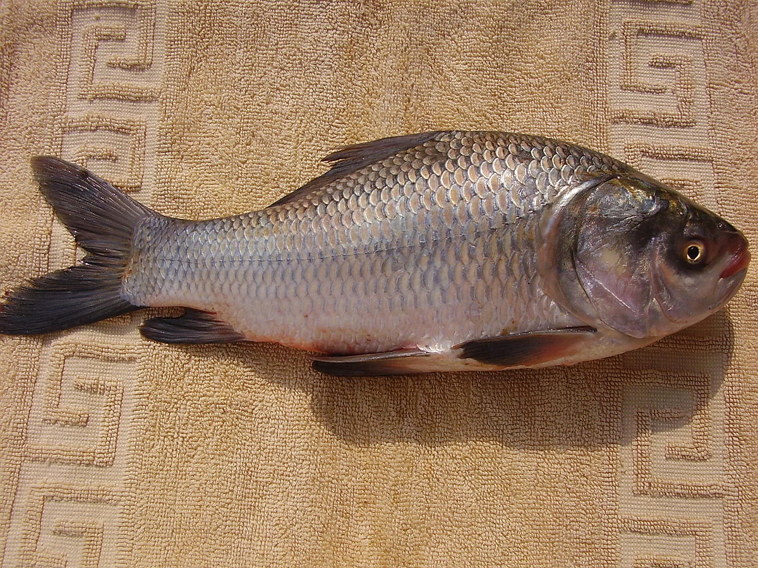
Catla
Systematic Position-
Phylum- Chordata
Class- Pisces
Order- Cypriniforms
Family- Cyprinidae
Genus- Catla
Species catla
Catla

Slide 7
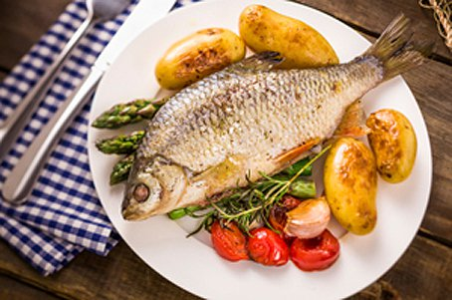
Identification characters-
Body is deep and broad.
Dorsal surface is more convex.
Dorsal surface is blackish or greyish, lateral side are silvery and ventral side is whitish.
Eyes are large and rounded.
Mouth is large and upturned.
Dorsal fin is quite large.
Habit and Habitat-
They are commonly fresh water, found in ponds and rivers.
They are found throughout India.
Economic Importance-
It is also important as a Food-fish

Slide 8
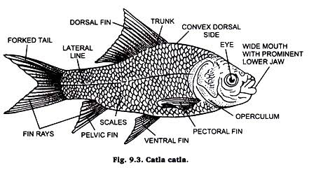

Slide 9
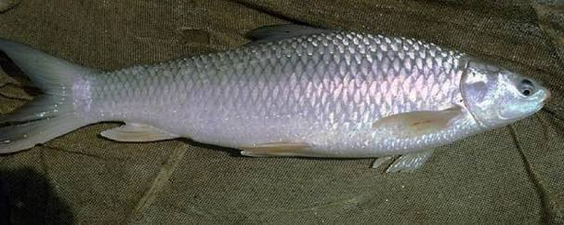
Mrigal
Systematic Position-
Phylum- Chordata
Class- Pisces
Order- Cypriniforms
Family- Cyprinidae
Genus- Cirrhinus
Species mrigala
Mrigala

Slide 10
Identification characters-
Body is elongated, streamlined and spindle-shaped.
Body colour is silvery with grey back.
Fins are Orange-Red coloured with black tips.
Eyes are anteriorly located and golden coloured.
Mouth is terminal and wide.
Lateral line is clear.
2-4 barbels are small in fold of lip.
Habit and Habitat-
They are commonly fresh water, found in ponds and rivers.
They are found throughout India.
Economic Importance-
It is also important as a Food-fish.

Slide 11
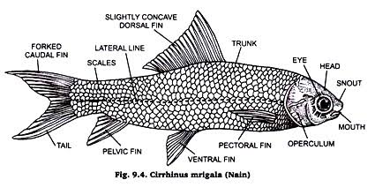

Slide 12
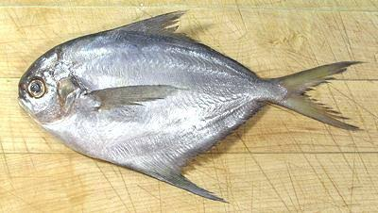
Pomphret
Systematic Position-
Phylum- Chordata
Class- Actinopterygii
Order- Periciforms
Family- Bramidae
Genus- Brama
Species brama
Pomphret

Slide 13
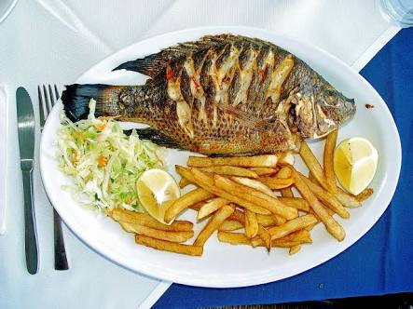
Identification characters-
Head is short and compressed.
Snout is blunt, overhanging the mouth.
Jaws are equal and lips are thin.
Lateral line is smooth and indefinite.
Anal fin deeply forked with 32-42 rays.
Habit and Habitat-
They are commonly fresh water, found in ponds and rivers.
They are found throughout India.
Economic Importance-
It is commercially important.

Slide 14
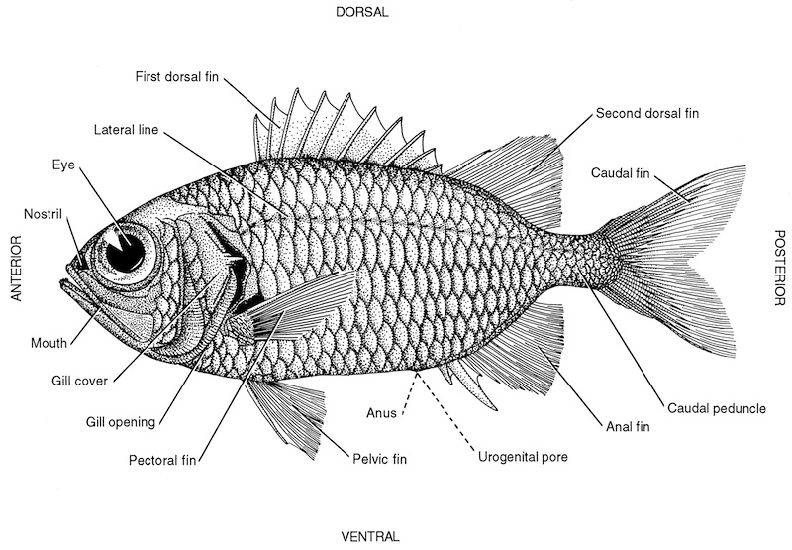

Slide 15
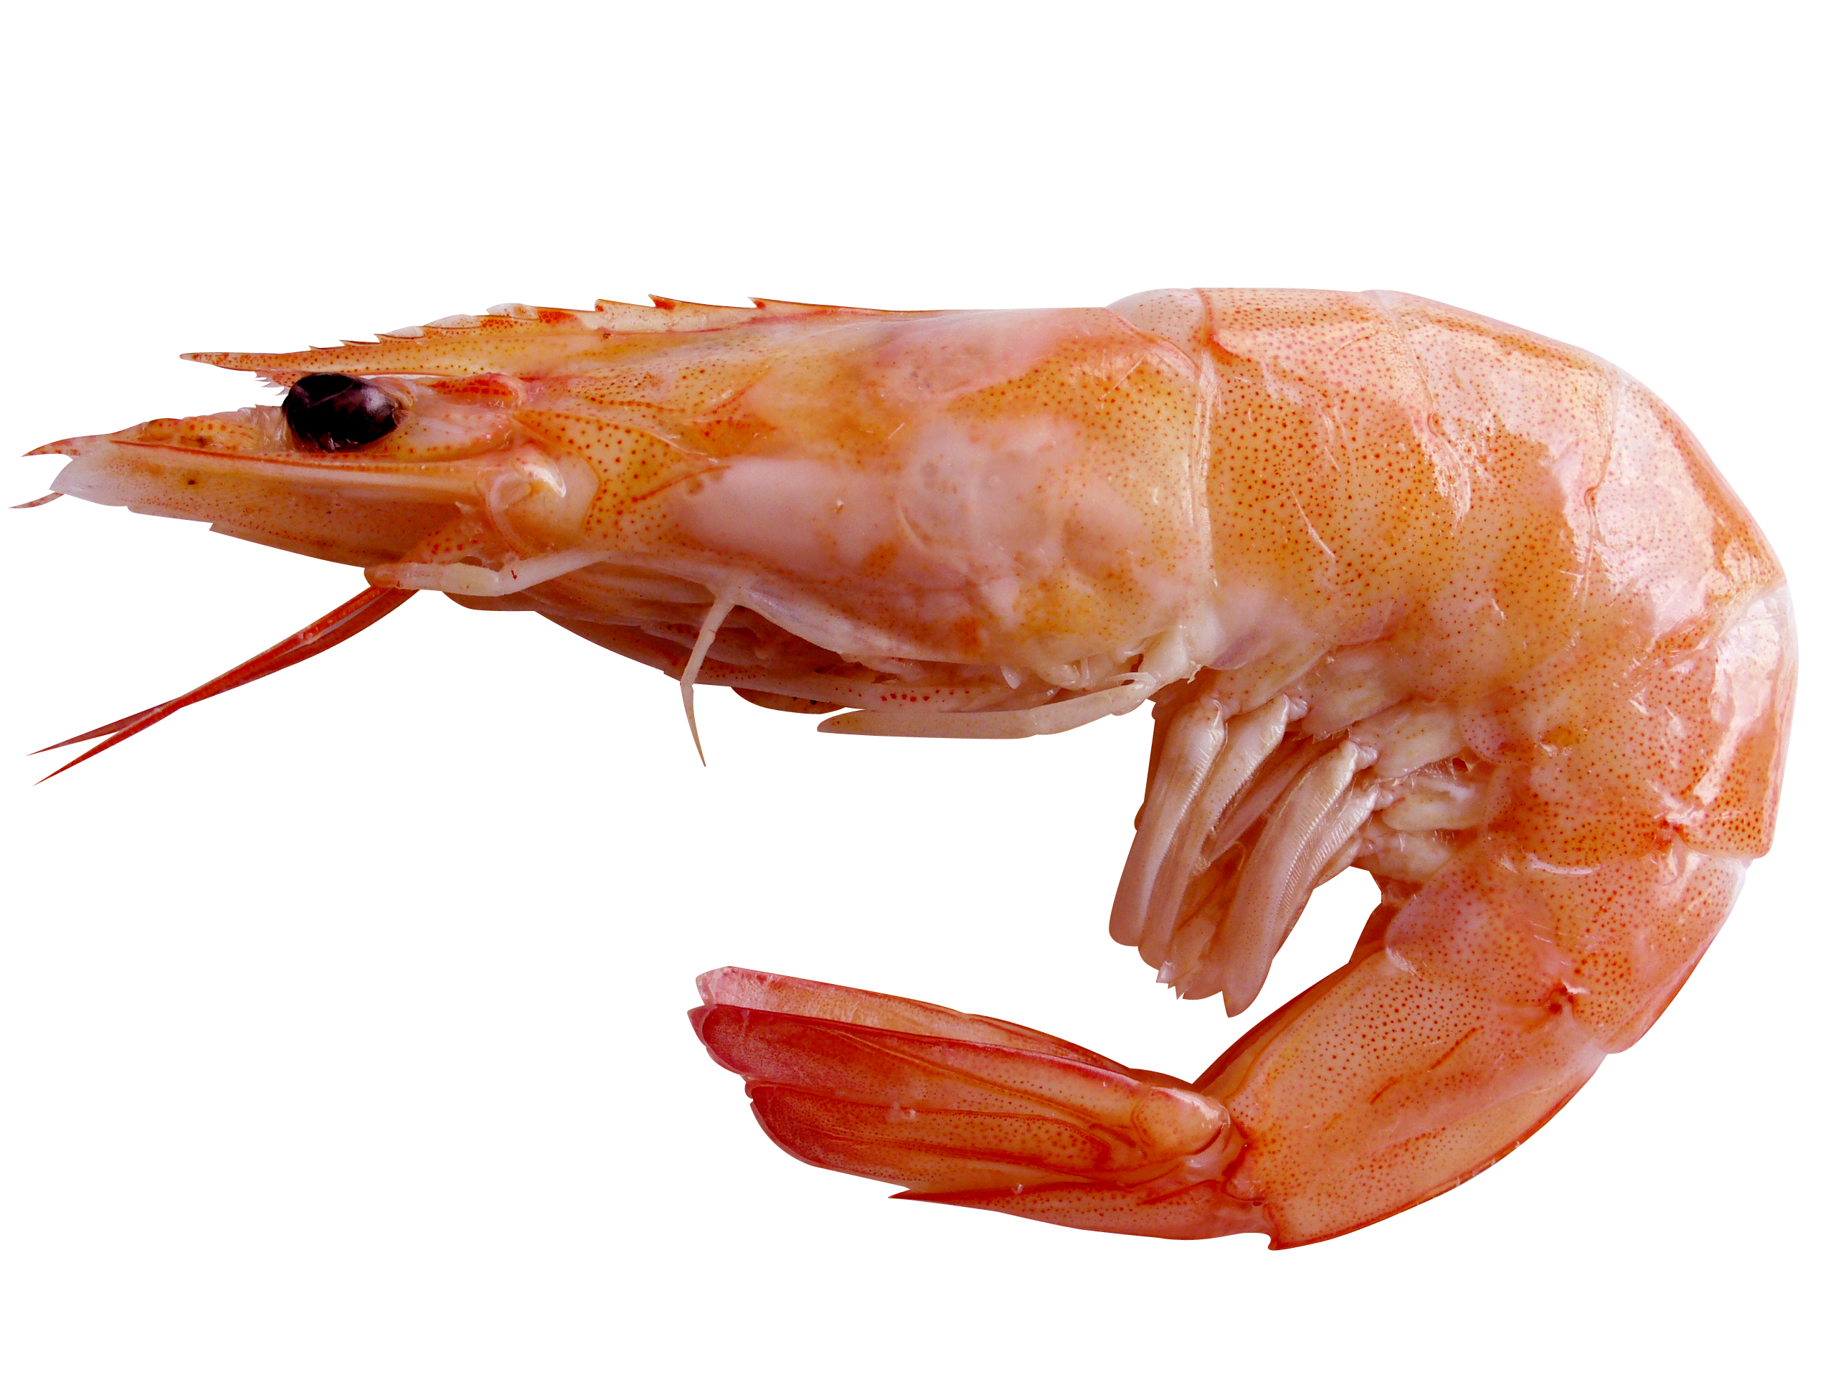
Prawn
Systematic Position-
Phylum- Arthropoda
Class- Malacostraca
Order- Decapoda
Family- Palaemonidae
Genus- Macrobrachium
Species rosenbergii

Slide 16

Identification characters-
It is Pinkish coloured and features reddish spots and lines.
It has large rostrum front of eyes.
Just below the eyes on either side is the Antennules.
Below the antennules Antenna are present.
Head and thorax is protected by thin Carapace.
They bears six abdominal segments.
First 5 abdomen bears fringed appendages called Pleopods or swimmerets.
Habit and Habitat-
They are commonly found in Marine and Brackish water.
Some are found in River, Reservoirs and Estuaries.
They are found throughout India.
Economic Importance-
It is also important as a Food-fish due to highly Nutritive

Slide 17
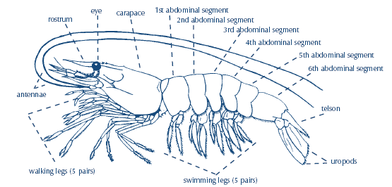

Slide 18

Thank
You

