Slide 1



Loknete Dr. Balasaheb Vikhe Patil
(Padmabhushan Awardee)
Pravara Rural Education Society
Arts Commerce & Science College, Alkuti
Department of Chemistry
By Mr.Balsane S.V.
Lecture-II
Subject:- Nuclear Magnetic Resonance (NMR) Spectroscopy

Slide 2
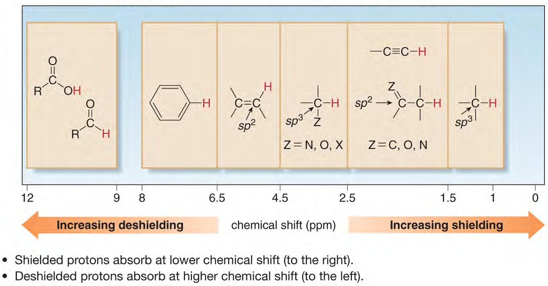
Regions in the ¹H NMR Spectrum

Slide 3
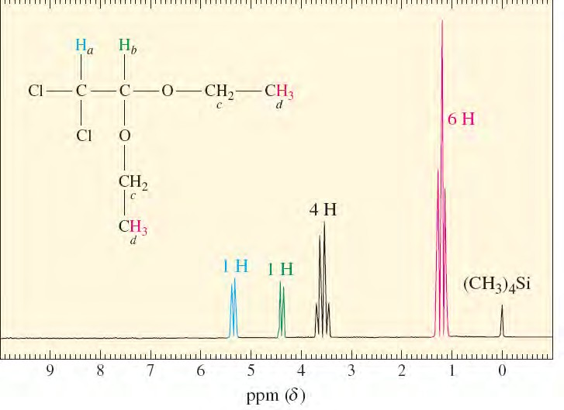
Local-­‐field contributions from more than one hydrogen are additive.
Consider the triplet above. It corresponds to the methyl protons being split by the methylene protons.
The methylene proton spins will statistically orient in the external magnetic field as αα, αβ, βα and ββ. Each methyl proton will see an increased field 25% of the time (αα), no change 50% of the time (αβ and βα), and a decreased field 25% of the time (ββ).

Slide 4
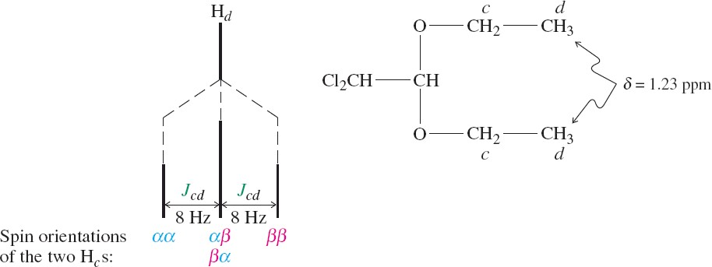
The integrated intensity of the triplet will be 6 since there are a total of 6 equivalent methyl protons.

Slide 5
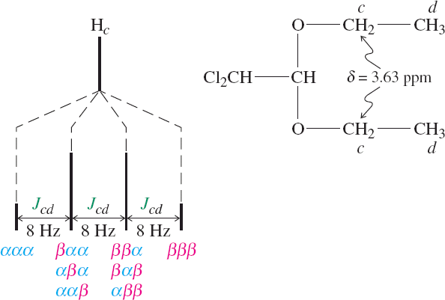
In the case of the methylene protons, the methyl proton spins will statistically distribute as ααα, ααβ, αβα, βαα, αββ, βαβ, ββα, and βββ.
This will result in a 1:3:3:1 quartet of peaks.
The integrated intensity of the quartet will be 4, corresponding to the 4 equivalent methylene protons.

Slide 6
In many cases, spin-­‐spin splitting is given by the N+1 rule.
A simple set of rules:
Equivalent nuclei located adjacent to one neighboring hydrogen resonate as a doublet.
Equivalent nuclei located adjacent to two hydrogens of a second set of equivalent nuclei resonate as a triplet.
Equivalent nuclei located adjacent to a set of three equivalent hydrogens resonate as a quartet.

Slide 7
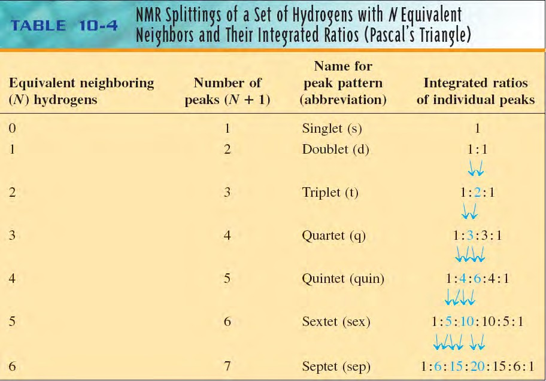
In many cases, spin-­‐spin splitting is given by the N+1 rule.
This table illustrates the N+1 rule: Nuclei having N adjacent equivalent neighbors split into N+1 peaks. The heights of the N+1 peaks follow Pascal’s triangle.

Slide 8
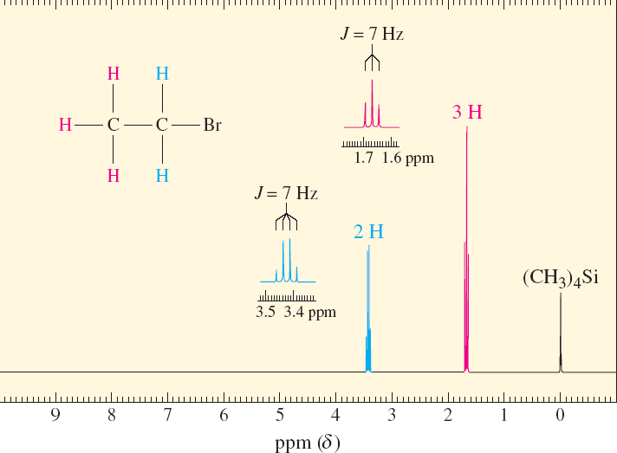
It is important to note that non-­‐equivalent nuclei split each other.
A split in one requires a split in the other. In addition, the coupling constants will be the same for each type of nuclei.
Two additional examples:

Slide 9
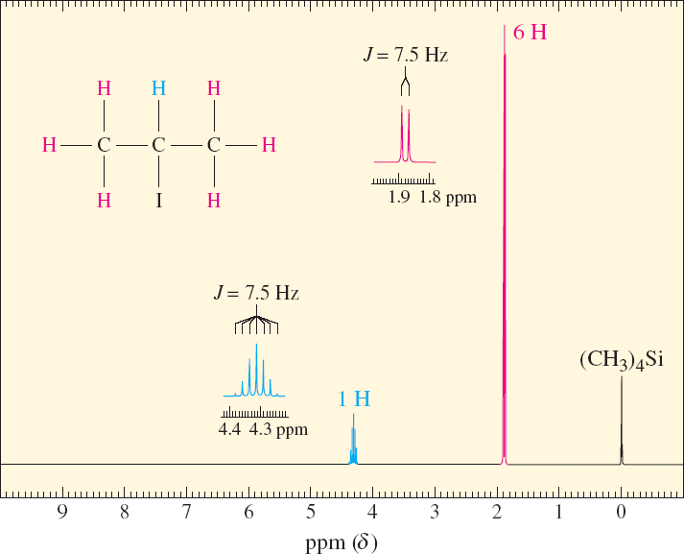

Slide 10
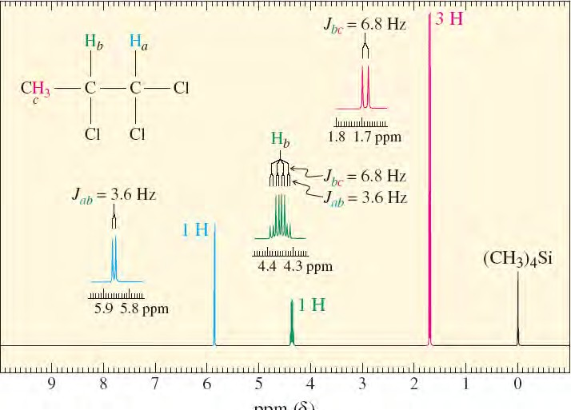
10-8 Spin-­‐Spin Splitting: Some Complications
The N+1 rule may not apply in a direct way if several neighboring hydrogens having fairly diﬀerent coupling constants are coupled to the resonating nucleus.
In this case, the rule is revised to (n1+1) * (n2 + 1).

Slide 11
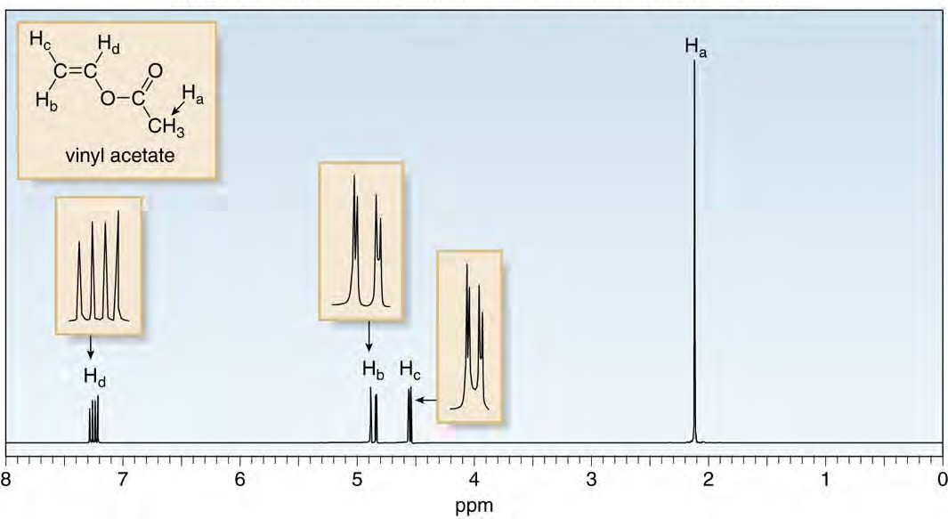
¹H NMR of Vinyl Acetate

Slide 12
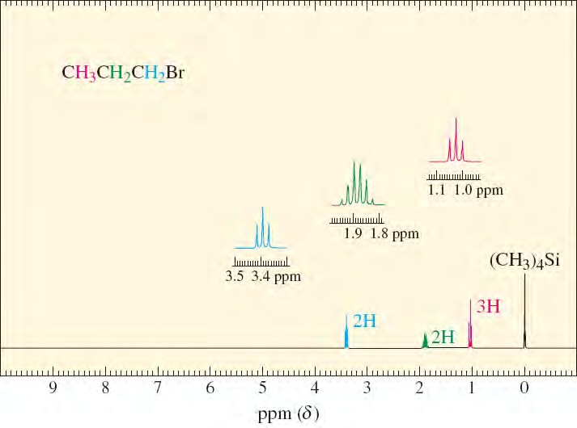
In the case of 1-­‐bromopropane, the hydrogens on C2 are also coupled to two non-­‐ equivalent sets of neighbors. A theoretical analysis of this resonance would predict as many as 12 lines (a quartet of triplets).
Because the coupling constants are very similar, however, many of the lines overlap, thus simplifying the pattern.

Slide 13
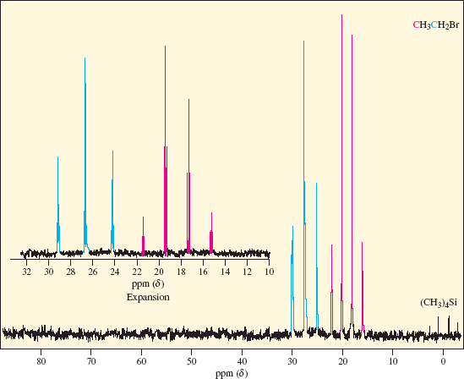
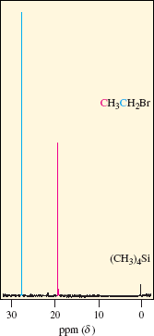
Carbon-­‐13 Nuclear Magnetic Resonance
The NMR spectroscopy of ¹³C is very useful for structural determination.
¹H-­‐Decoupling

Slide 14
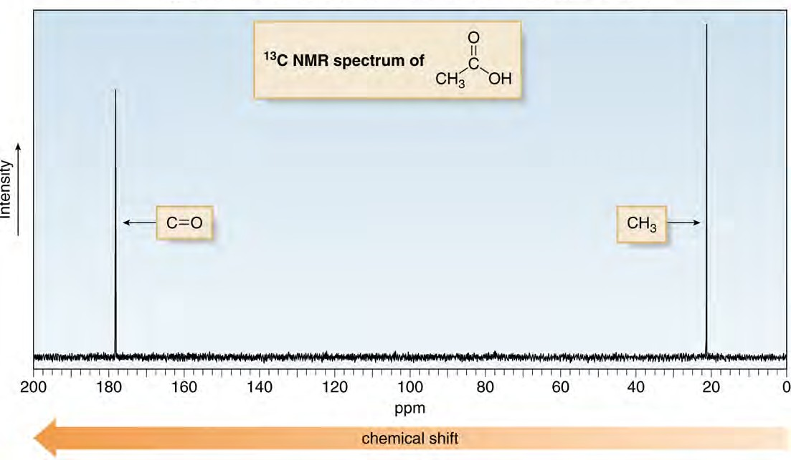
¹³C NMR Spectrum Example
¹³C Spectra are easier to analyze than ¹H spectra because the signal splitting can be avoided.
Each type of carbon atom appears as a single peak with 1H- decoupling.

Slide 15
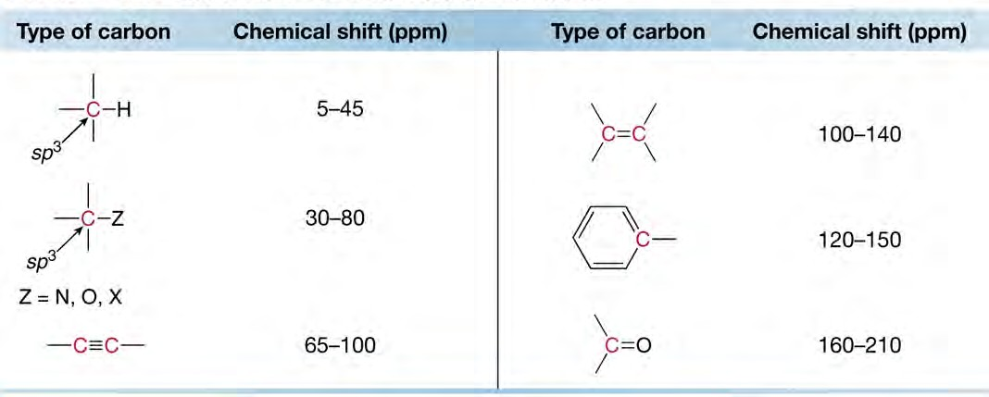
Chemical Shifts in ¹³C NMR
In contrast to the small range of chemical shifts in ¹H NMR (1-10 ppm usually), ¹³C NMR absorptions occur over a much broader range (0-220 ppm).
The chemical shifts of carbon atoms in ¹³C NMR depend on the same effects as the chemical shifts of protons in ¹H NMR.
Common ¹³C-­‐NMR chemical shift values

Slide 16
How to determine structures of compounds from their spectra?
Determine the molecular formula and degree of unsaturation
2. From ¹H-­‐NMR, determine # of signals, # of protons in each signal, peak splitting patterns and chemical shifts

Slide 17
THANK YOU

