Slide 1



Loknete Dr. Balasaheb Vikhe Patil
(Padmabhushan Awardee)
Pravara Rural Education Society
Arts Commerce & Science College, Alkuti
Department of Chemistry
By Mr. Balsane S.V.
Lecture-1
Subject:- Nuclear Magnetic Resonance (NMR) Spectroscopy

Slide 2
Structural Information from Features of a
¹H NMR Spectrum
Position of signals: Indicates what types of hydrogen the molecule contains.
Number of signals: Indicates the number of different types of hydrogen in a molecule ( n+1 Rule ).
Intensity of signals: Indicates the relative amounts (how many) of each kind of hydrogen in the molecule.
Spin-spin splitting of signals: Gives further information of the neighboring environment for the various hydrogens in the molecule.

Slide 3
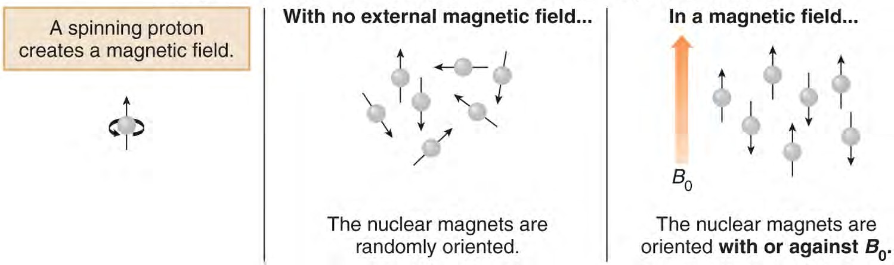

Slide 4
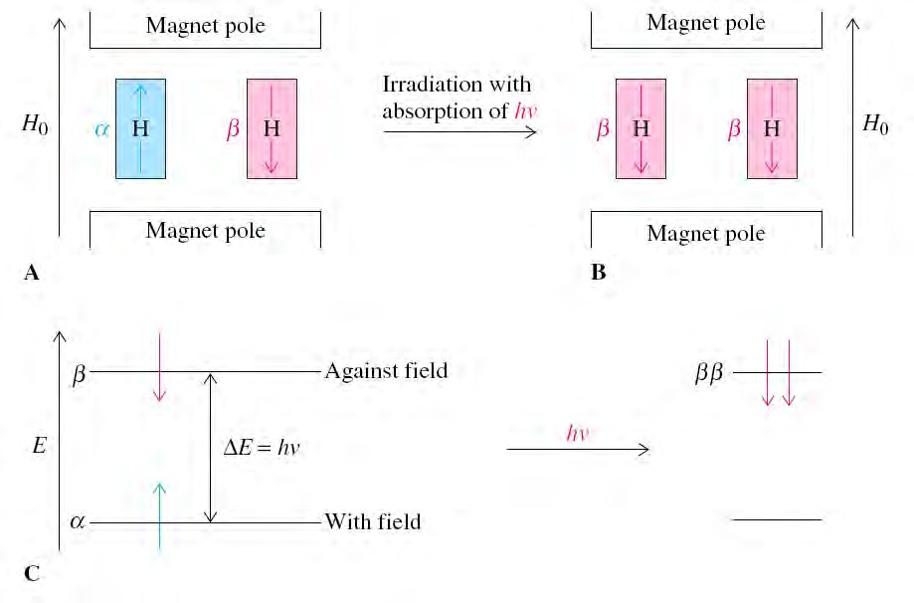

Slide 5
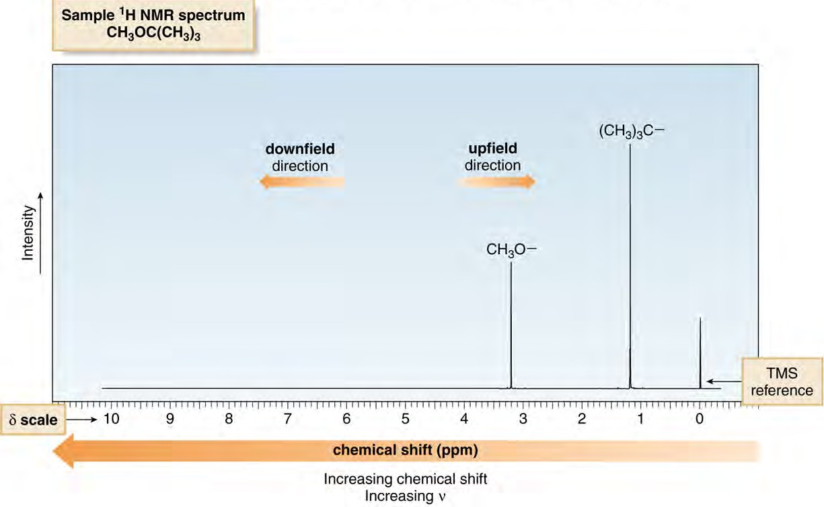
¹H NMR Spectra
An NMR spectrum is a plot of the intensity of a peak against its chemical shift, measured in parts per million (ppm).

Slide 6
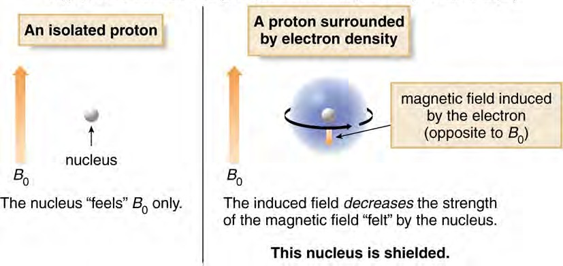
Shielding and Chemical Shift
Protons in a given environment absorb in a predictable region in an NMR spectrum.
Two important factors: electronegativity and magnetic anisotropy

Slide 7
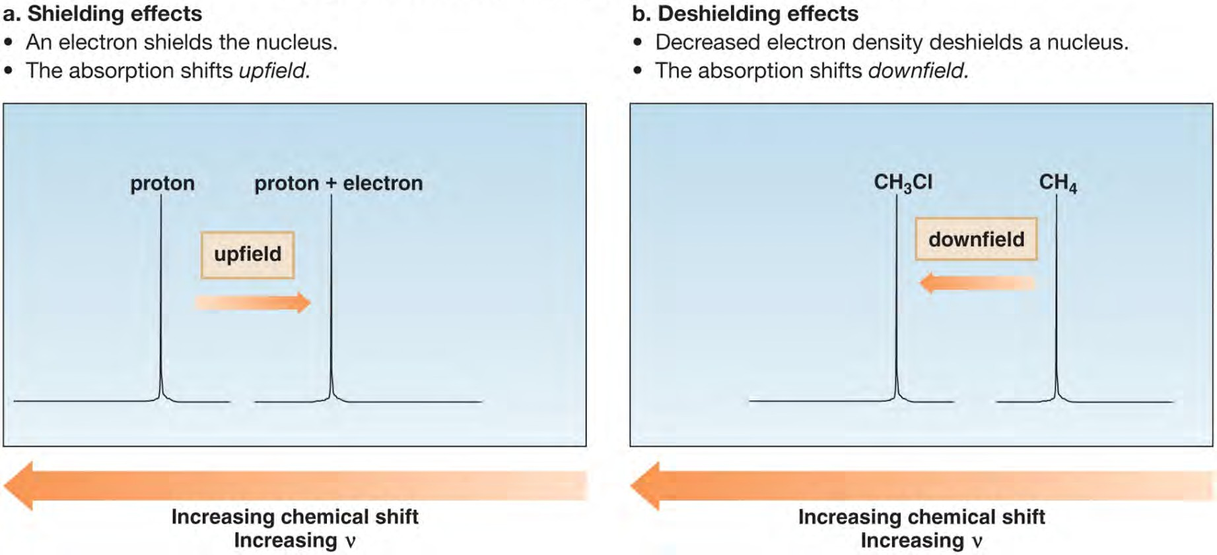
Shielding and Chemical Shift
The degree of shielding of a nucleus depends upon its surrounding electron density.
Adding electrons increases shielding.
Removing electrons causes deshielding.

Slide 8
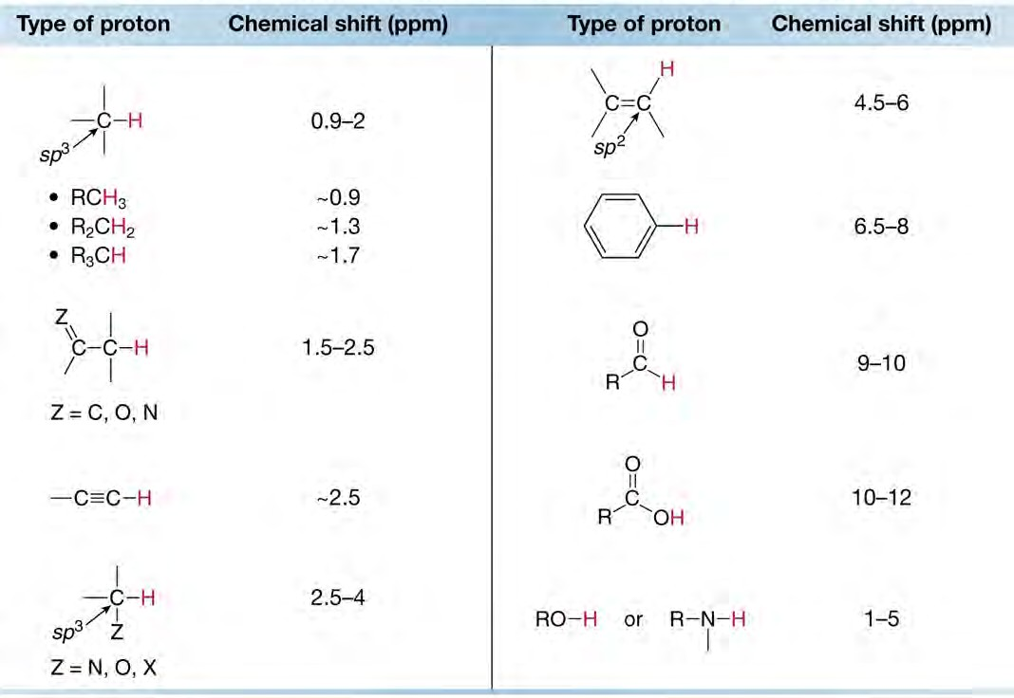
Characteristic Chemical Shifts Relative to TMS (0 ppm)

Slide 9
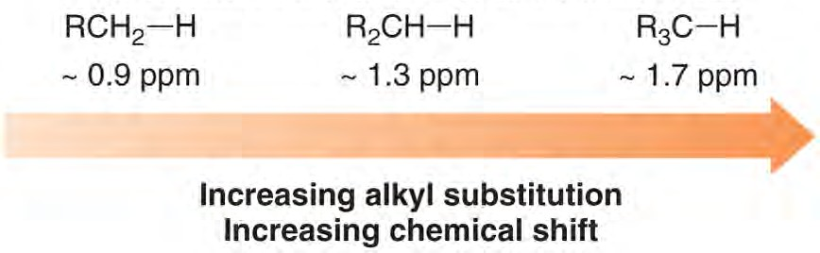
Electronegativity and Chemical Shift
The chemical shift of a C−H bond increases with increasing alkyl substitution or electronegative atoms attached.
RCH₂-­‐H
RCH₂-­‐OH

Slide 10
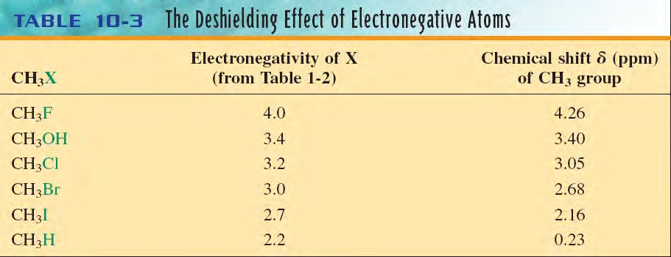
The absorptions of alkane hydrogens occur at relatively high field.
Hydrogens close to an electron withdrawing group (halogen or oxygen) are shifted to relatively lower field (deshielding).
The more electronegative the atom, the more the deshielded methyl hydrogens are relative to methane.

Slide 11
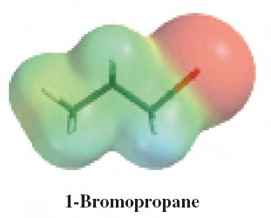
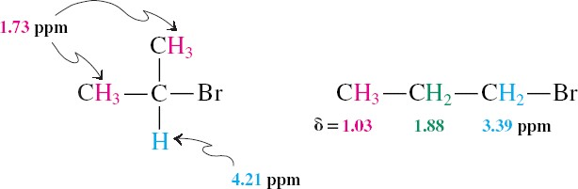
The deshielding inﬂuence of electron withdrawing groups diminishes rapidly with distance.

Slide 12
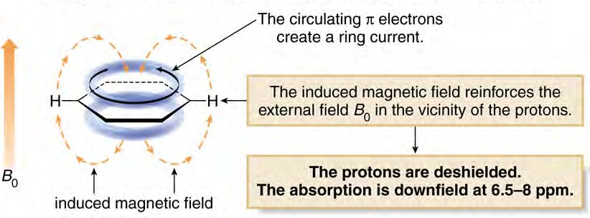
Aromatic Deshielding and Anisotropy
In a magnetic field, the six π electrons in benzene circulate around the ring creating a ring current.
The magnetic field induced by these moving electrons reinforces the applied magnetic field in the vicinity of the protons.
The protons thus feel a stronger magnetic field and a higher frequency is needed for resonance meaning they are deshielded and absorb downfield.

Slide 13
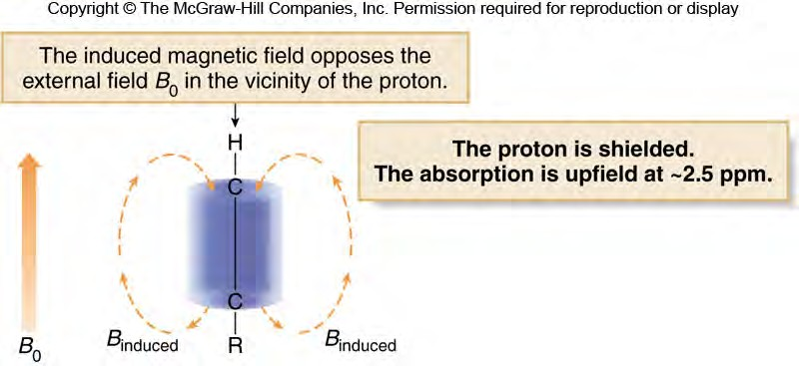
Alkyne Chemical Shifts
In a magnetic field, the π electrons of a carbon-carbon triple bond are induced to circulate, but in this case the induced magnetic field opposes the applied magnetic field (B₀).
The proton thus feels a weaker magnetic field, so a lower frequency is needed for resonance.
The nucleus is shielded and the absorption is upfield.

Slide 14
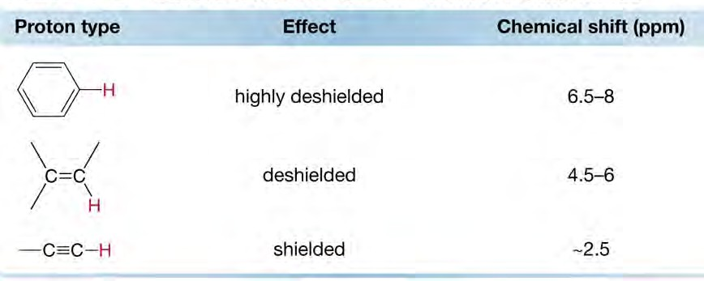
Summary of π Electron and Chemical Shift

Slide 15
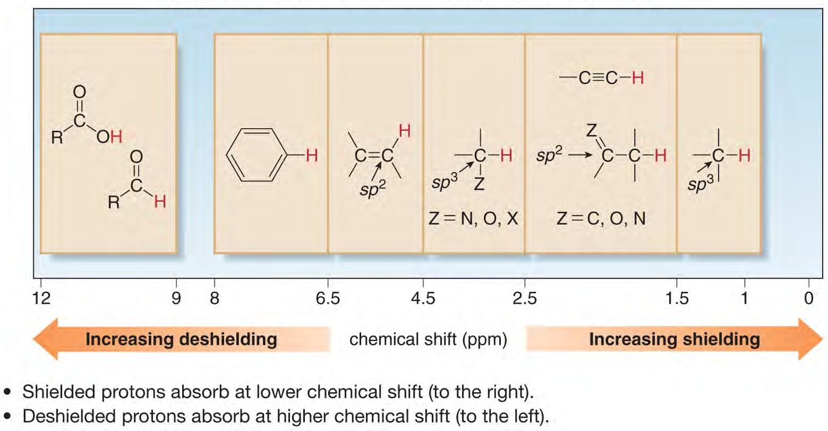
Regions in the ¹H NMR Spectrum

Slide 16
THANK YOU

